Slide 1
Creating Moodle Mobile remote themes
Juan Leyva & Daniel Palou
@moodlemobileapp #mootieuk16
@jleyvadelgado

Slide 2
What will we do?
Learn how to run Moodle Mobile in a browser.
Create a Mobile theme progressively.
Upload and configure this new theme in Moodle.
Learn some tricks to improve how the theme is downloaded.

Slide 3
Moodle Mobile in the browser
Several ways to do that:
Advanced: https://docs.moodle.org/dev/Setting_up_your_development_environment_for_Moodle_Mobile_2
Simple:
Download the latest build, and open it in your browser: https://github.com/moodlehq/moodlemobile-phonegapbuild

Slide 4
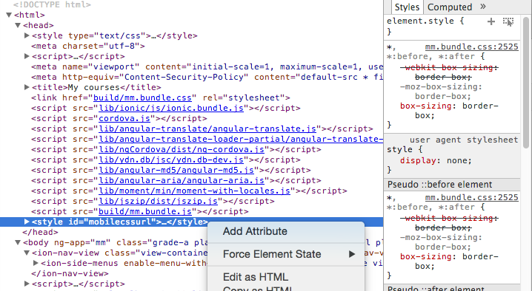
Moodle Mobile in the browser
You can add your custom CSS via the browser inspection tools:

Slide 5
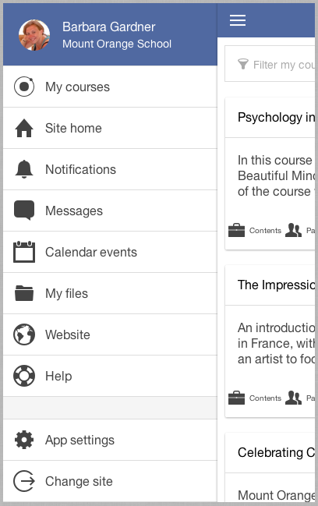
Mobile theme
Change the top bars:
.bar-header {
background-color: #5069A1;
}
There are different styles for the menu and main content bar, you may use different colors.

Slide 6
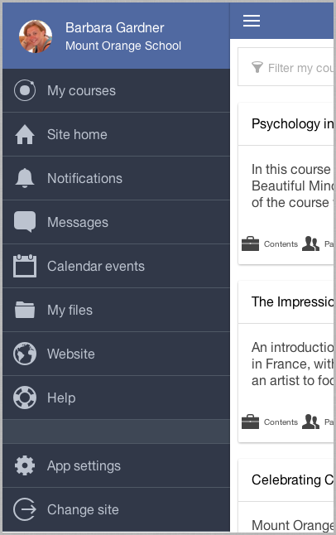
Mobile theme
Change the side menu elements:
ion-side-menu li .item {
background-color: #313848;
border-color: #4F5865;
color: #BCC3CF;
}
ion-side-menu li.item {
border-color: #4F5865;
}
ion-side-menu li.item.item-divider {
background-color: #3E4755;
}

Slide 7
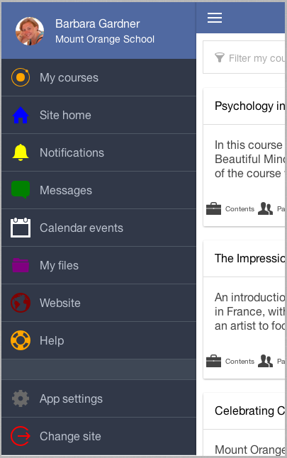
Mobile theme
Change icon colors:
.ion-ionic { color: orange; } .ion-home { color: blue; } .ion-ios-bell { color: yellow; } .ion-chatbox { color: green; } .ion-calendar { color: white; } | .ion-folder { color: purple; } .ion-earth { color: maroon; } .ion-help-buoy { color: orange; } .ion-gear-b { color: dimgray; } .ion-log-out { color: red; }

Slide 8
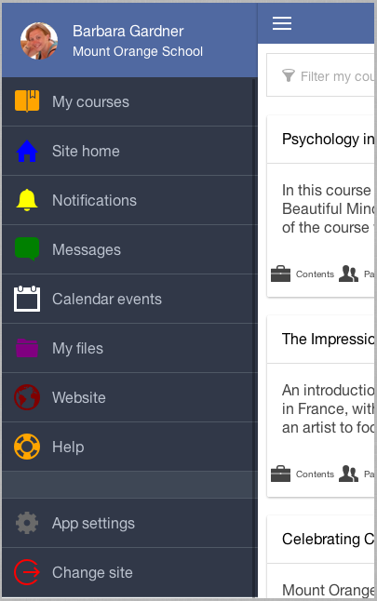
Mobile theme
Change icons:
For changing icons just search for the unicode tag near the icon name in: /www/lib/ionic/fonts/ionicons.svg (open it using a text editor)
.ion-ionic:before { content: "\f3ea"; }

Slide 9
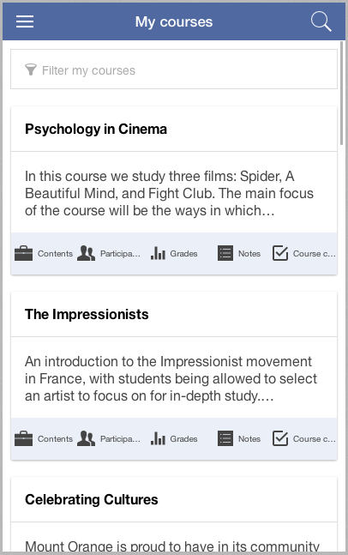
Mobile theme
Change other elements in pages inside the app: Every page has a different and unique base class, you can find it in the <ion-content> element.
Courses list page: .mm-site_mm_courses
.mm-site_mm_courses .tabs-icon-left {
background-color: #EBEFF8;
}
.mm-site_mm_courses section h2 span {
font-weight: bold;
}

Slide 10
Upload the theme
Upload and configure the theme in Moodle:
Upload the file containing the CSS code into your theme directory: theme/mytheme/mobileapp.css
In Site administration -> Plugins -> Web Services -> Mobile

Slide 11
Minify your CSS
There are lots of online tools for doing that, use Google :)
https://cssminifier.com/
http://www.cleancss.com/css-minify/
Optionally, you can force the file to be sent gzipped (compressed):
Rename the file from .css to .php
Add these lines at the beginning of the file:
<?php if(!ob_start("ob_gzhandler")) ob_start();
?> css code goes here...

Slide 12
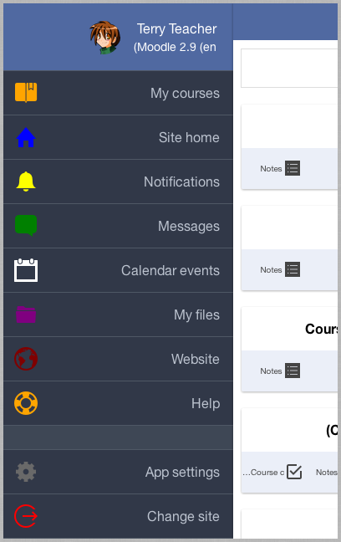
RTL
This is not fully supported in the app but it can be partially achieved applying this style into the body tag:
body {
direction: rtl;
text-align: right;
}

Slide 13
Thank you
the world’s open source learning platform
Community: moodle.org
Commercial: moodle.com
@moodle

